Slide 1
Electricity Billing System
By,
Naveenraj.B

Slide 2
INTRODUCTION
The main objective of our project is print the E-bill
with more accuracy .
It should be user friendly to the user.
It is very easy to use and save our time.
It reduce work of the EB employess.

Slide 3
BENEFITS
The UI should be user friendly to the user.
It has an automated calculation.
It is very easy to use.
The data is used in future purpose.
It reduce work of the EB employees.

Slide 4
PROCESS
1. User Input:
Get the main datas such as Customer ID, Customer Name, Unit from that particular customer.

Slide 5
2. Calculation:
The main purpose for this calculation process is calculate the amount based on the unit which is used by the customer.

Slide 6
UNIT | CHARGES
Less than 500. | Unit * 1
Between 500 to 600. | Unit * 1.8
Between 600 to 800. | Unit * 2
Greater than 800 | Unit * 3
After calculate the amount, it shows the final amount in the textarea with the respective username, userid, unit.

Slide 7
3. Print:
After calculate button shows all datas in the textarea.
Then, we click the print button present below the textarea.
It shows the options how we want that result.

Slide 8
And then, we click the print button in that print page,
it can save that result in the pdf format.
And we can able to print that pdf using any printer.

Slide 9
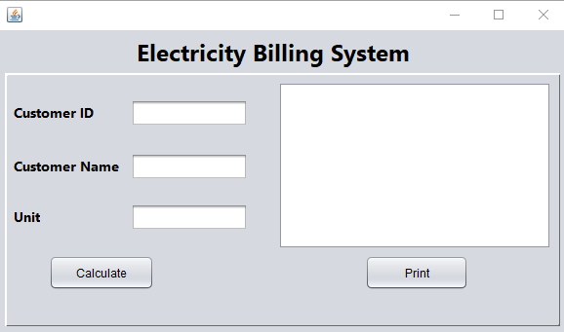
PRACTICAL RESULTS
This page is index page of our Software.

Slide 10
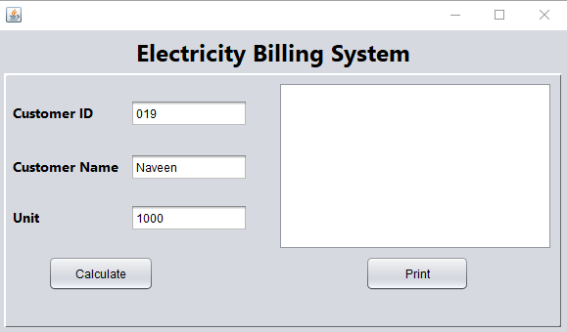
Here we get the input from the user.

Slide 11
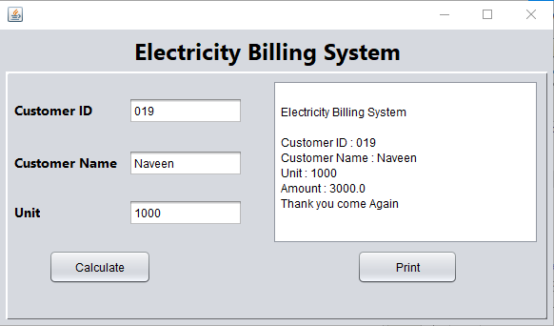
After we get the datas, then we click the Calculate button.
Then print the bill amount based on the units.

Slide 12
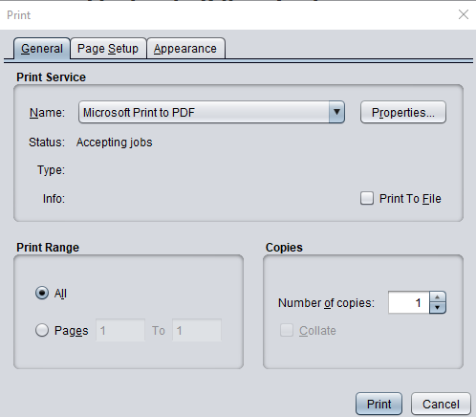
This page is come after we click the print button. After get
the amount in the textarea.

Slide 13
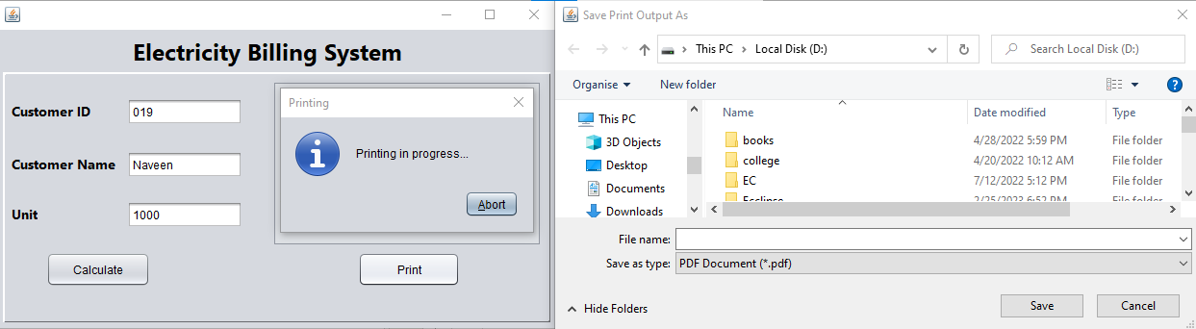
This page is come after click the print button in the previous
page. In this we can save that bill statement in the pdf format.

Slide 14
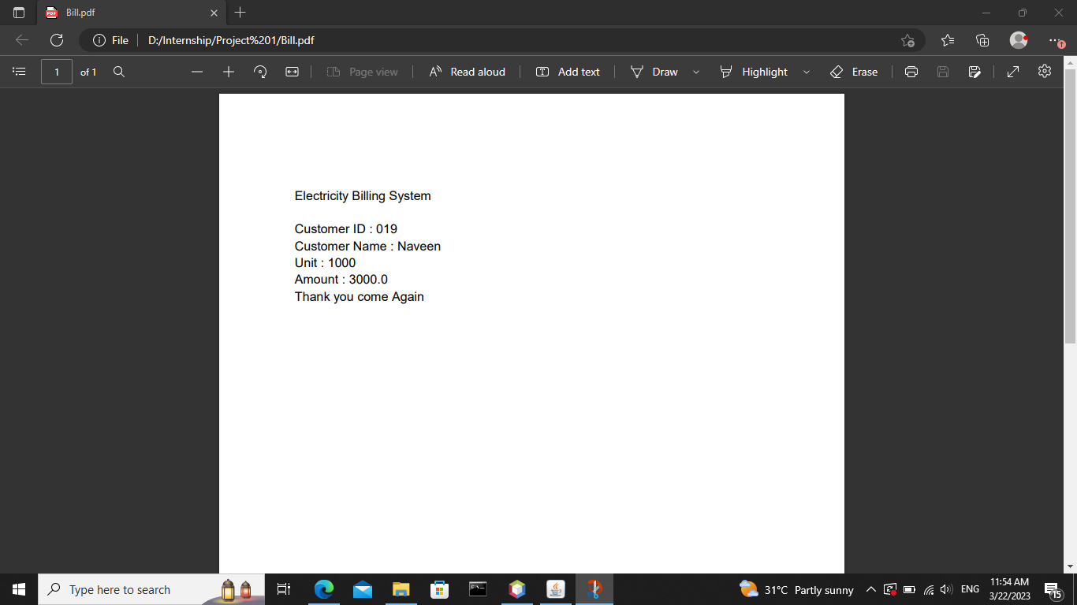
It is the pdf result we want to print.

Slide 15
SOFTWARE REQUIREMENTS
O/S : Windows 10
Language : Java
IDE : NetBeans 17

Slide 16
HARDWARE REQUIREMENTS
System : Pentium IV 2.4 GHz
Hard Disk : 160 GB
Monitor : 15 VGA color
Mouse : Logitech.
Keyboard : 110 keys enhanced
Ram : 4GB

